Slide 1
Network scientific analysis about the vulnerability of the Swiss Railway network
Network Science: Final Project
Mathias Lüthi
Nino Scherrer
Peter Giger

Slide 2
Overview
Motivation
Related Work
Swiss Railway Network
Approach
Results
Conclusion

Slide 3
Motivation

Slide 4
Remember the last time this happened?

Slide 5
Consequences

Slide 6
Facts and Figures (SBB)
Compensation for delays (around 10.- CHF when > 60 minutes)
Compensation for last scheduled connection (SBB organizes/pays accommodation or Taxi)
NO provision for missing flights, concerts, examinations, working hours….
+/- 3 minutes are tolerated
Punctuality of around 90% for a customer to move from A to B
Around 8000 problems per year
4 derailments in 2018
22 accidents in 2018

Slide 7
Related Work

Slide 8
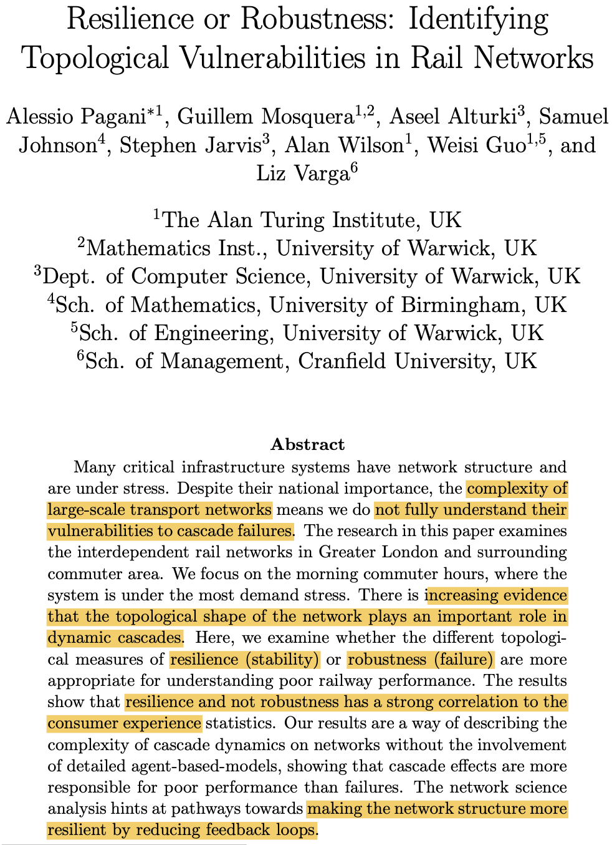
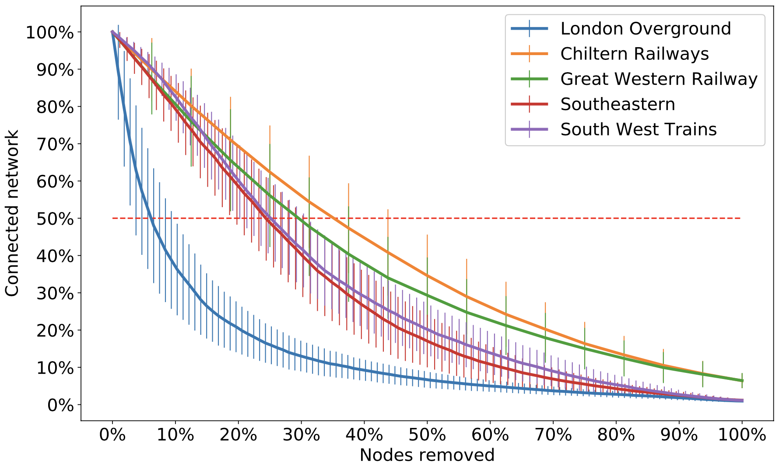
Identifying Topological Vulnerabilities in Rail Networks (2018)
Increasing evidence that the topological shape of the network plays an important role in dynamic cascades
Examine resilience (stability) and robustness (failure) of the UK rail network
Directed weighted graph (edges: passenger flow, nodes: train stations)

Slide 9
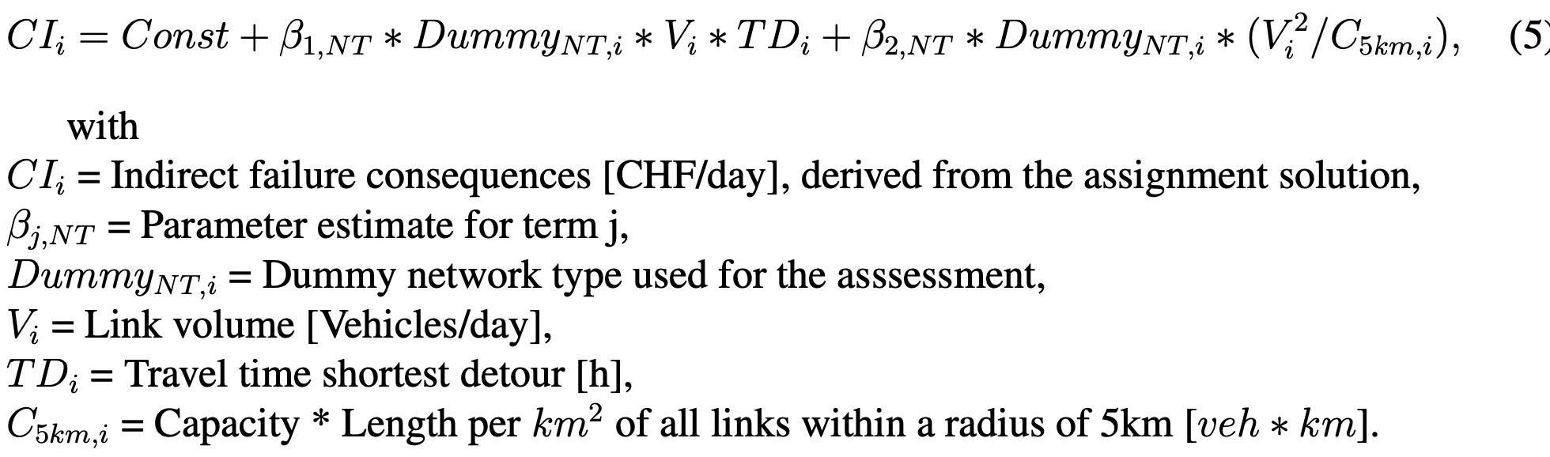
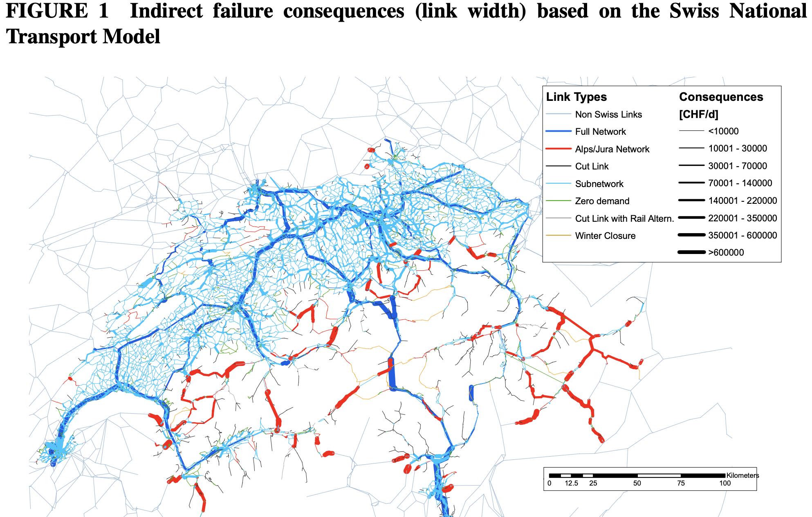
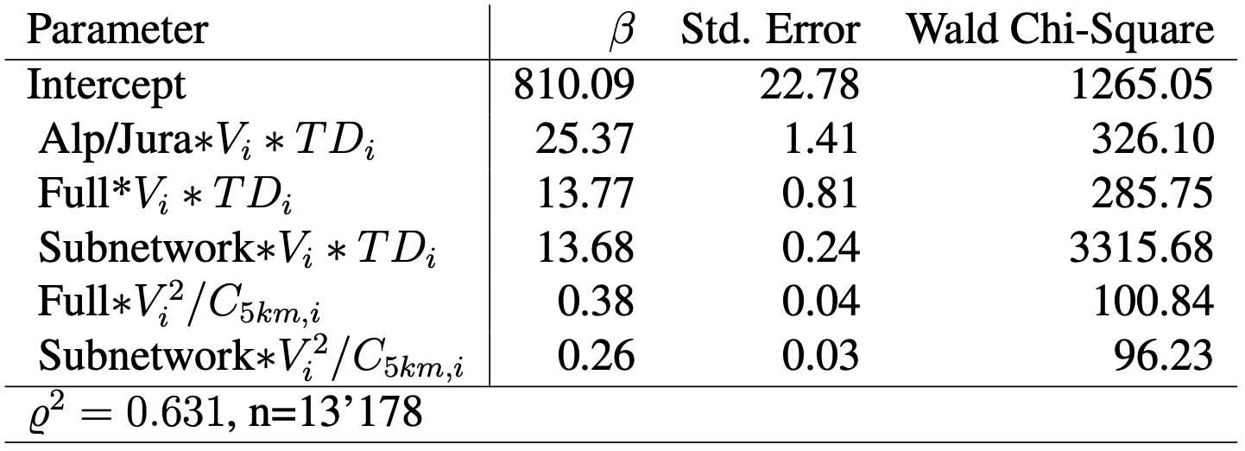
Vulnerability Assessment Methodology for Swiss Road Network (2009)
Generalized Linear Model
Each failure is assumed to be mutually exclusive

Slide 10
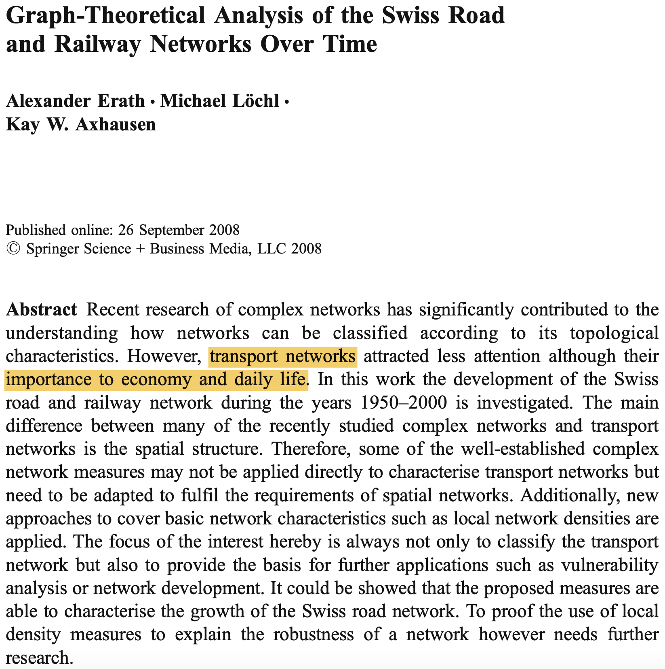
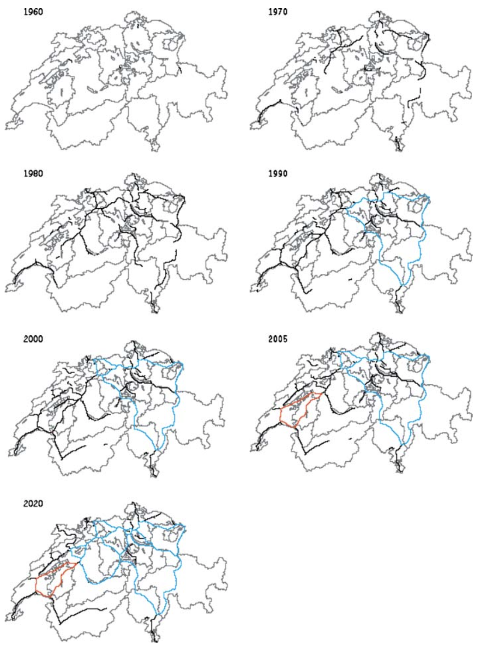
Graph-Theoretical Analysis of the Swiss Road and Railway Networks Over Time (2008)
Degree, closeness, betweenness centrality
Global/Local efficiency
Over time analysis

Slide 11
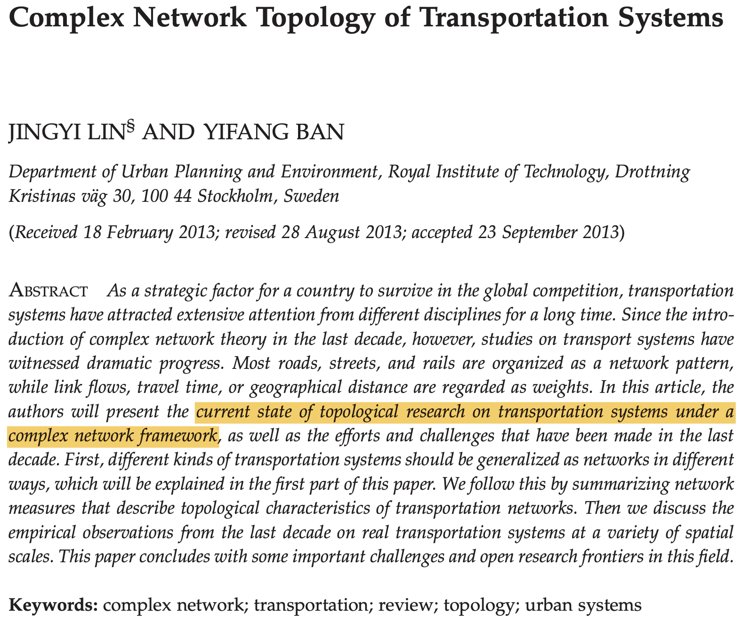
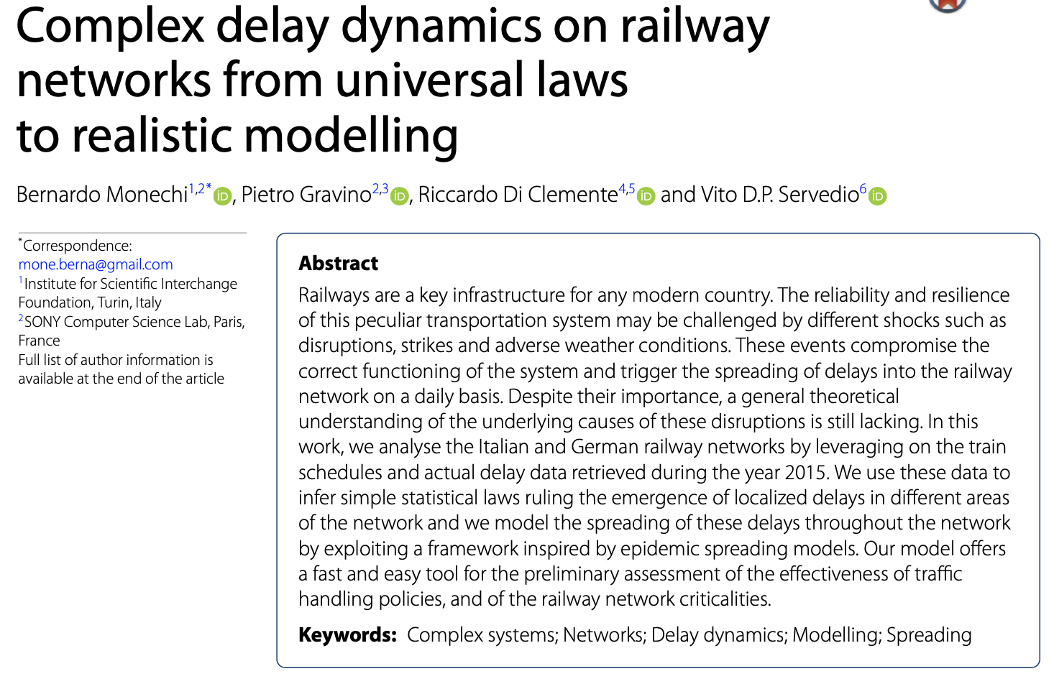
Less related work
L-Space and P-Space
Epidemic Spreading models

Slide 12
Swiss Railway Network

Slide 13
History
Construction and operation began in the 19th century
Mostly carried out by private railways → influences the network structure
In 1901, most railways were nationalized (SBB)
Electrified and upgraded
After WWII, trains lost ground to roads
In 2017, Switzerland was ranked first among European rail systems
Alps covering around 60% of the surface
One of the worlds most dense railway networks!

Slide 14
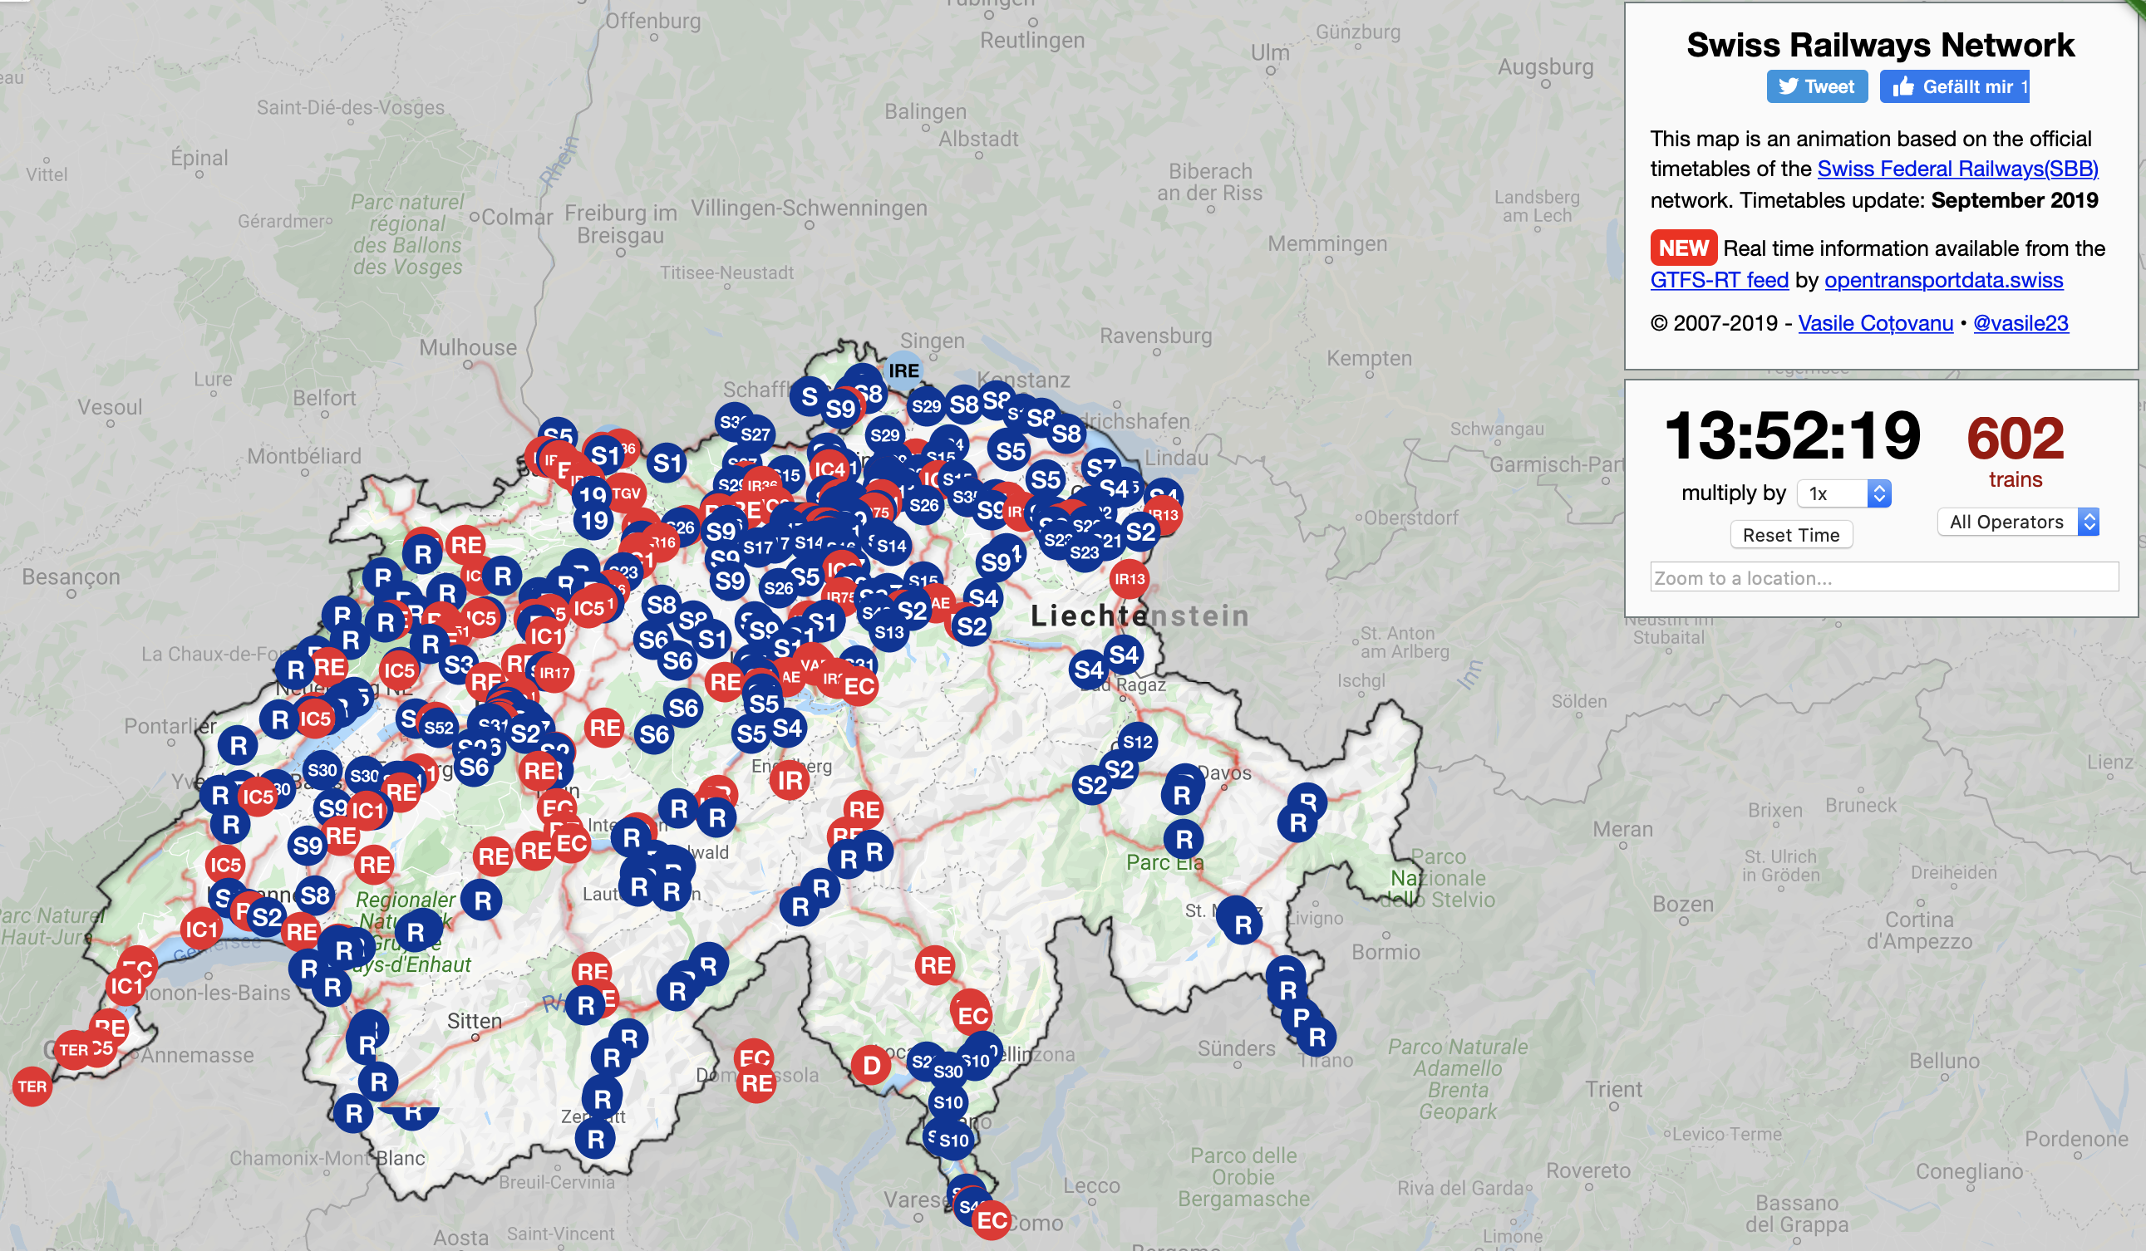
Map
http://maps.vasile.ch/transit-sbb/

